Slide 1

Mobile Cellular and Internet Usage

Slide 2
Introduction
The world is becoming increasingly connected, and this connectivity can profoundly affect the populations of countries worldwide. I examined a dataset that contains four distinct metrics capturing how connectivity is distributed globally. The dataset provides information about countries worldwide from 1965 to 2019. Most of my analysis focused on the period from the beginning of the 21st century to just short of the present.
The areas of focus were as follows:
Broadband penetration (broadband users per 100 people)
Mobile cellular subscriptions per 100 people
Total number of internet users in a country
Share of individuals in a country using the internet (as a percentage)

Slide 3
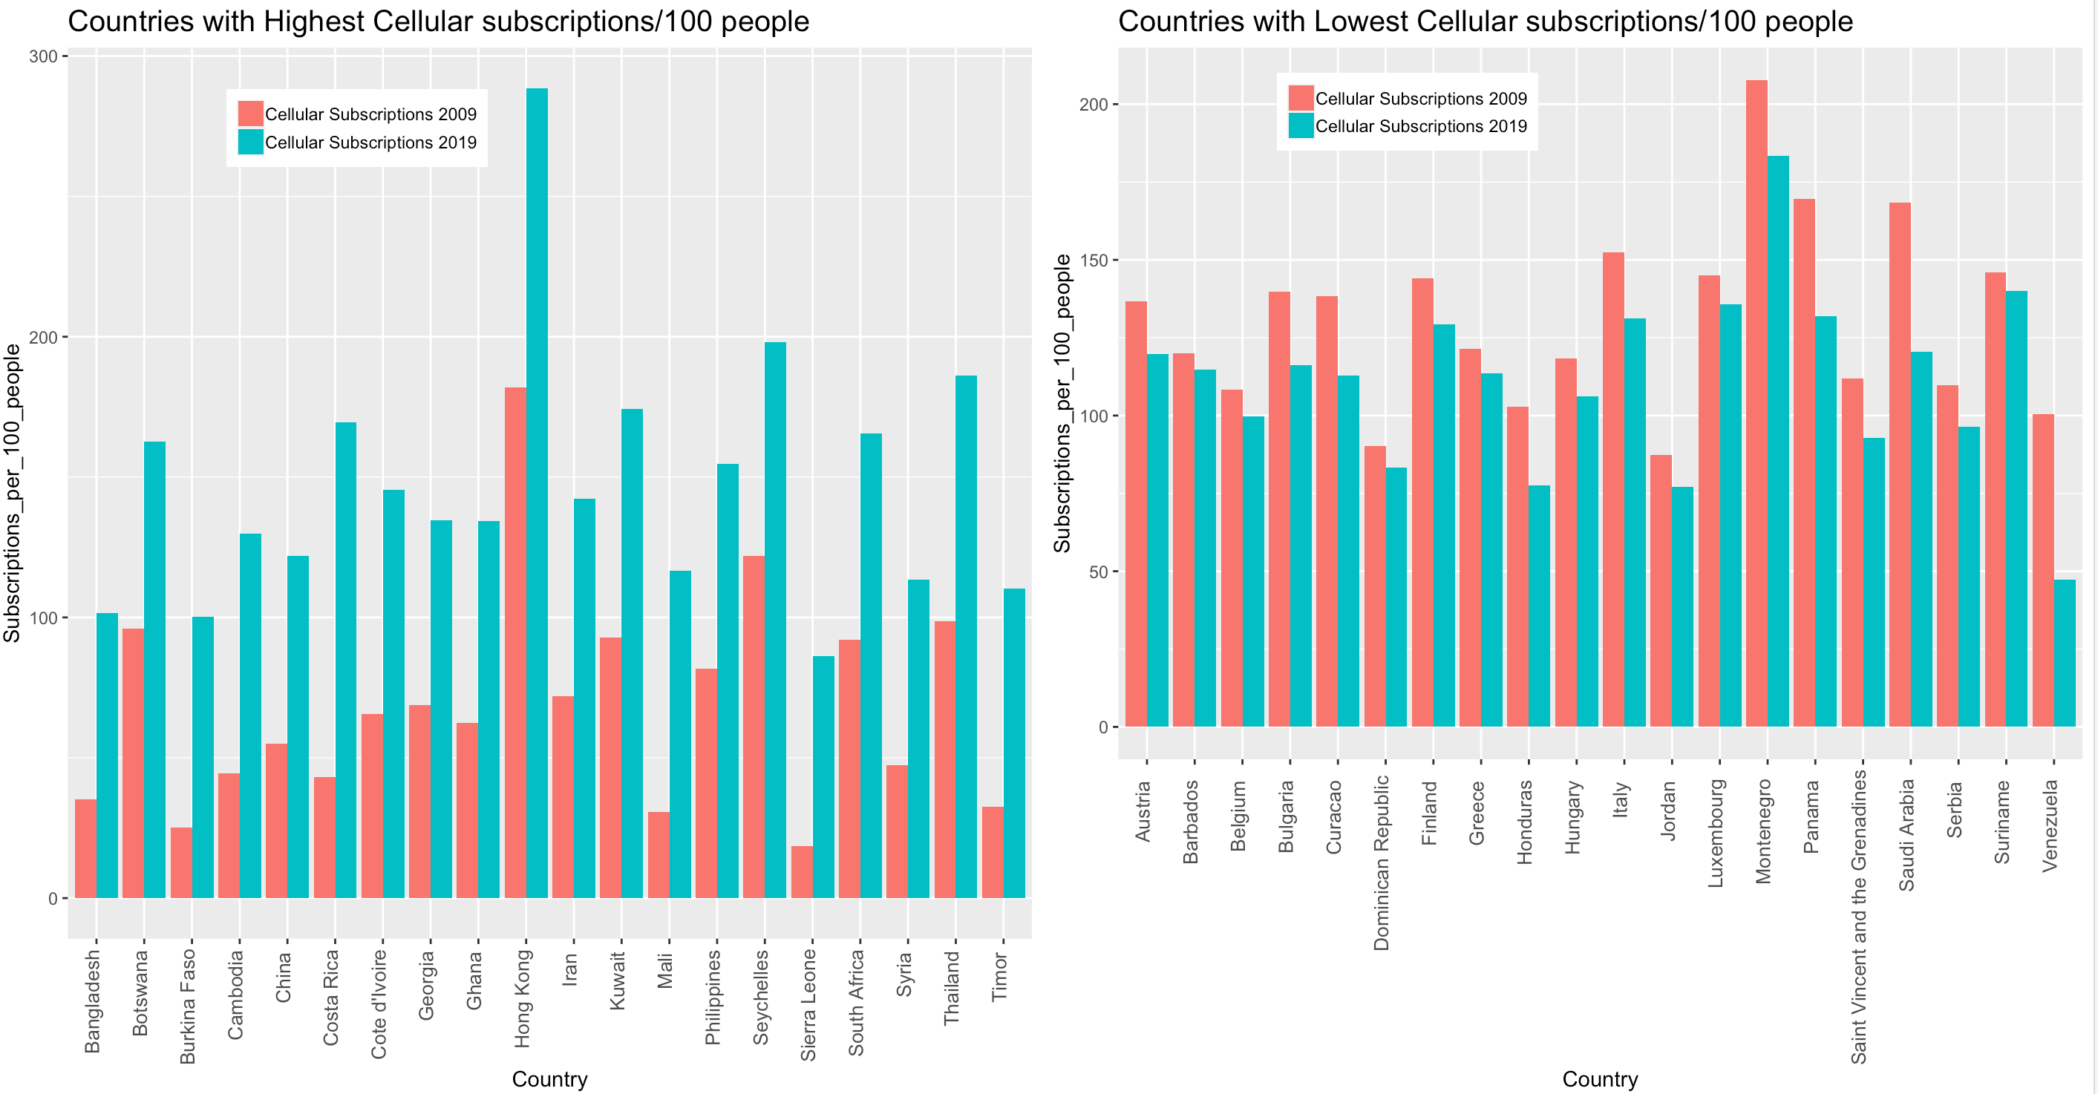

Slide 4
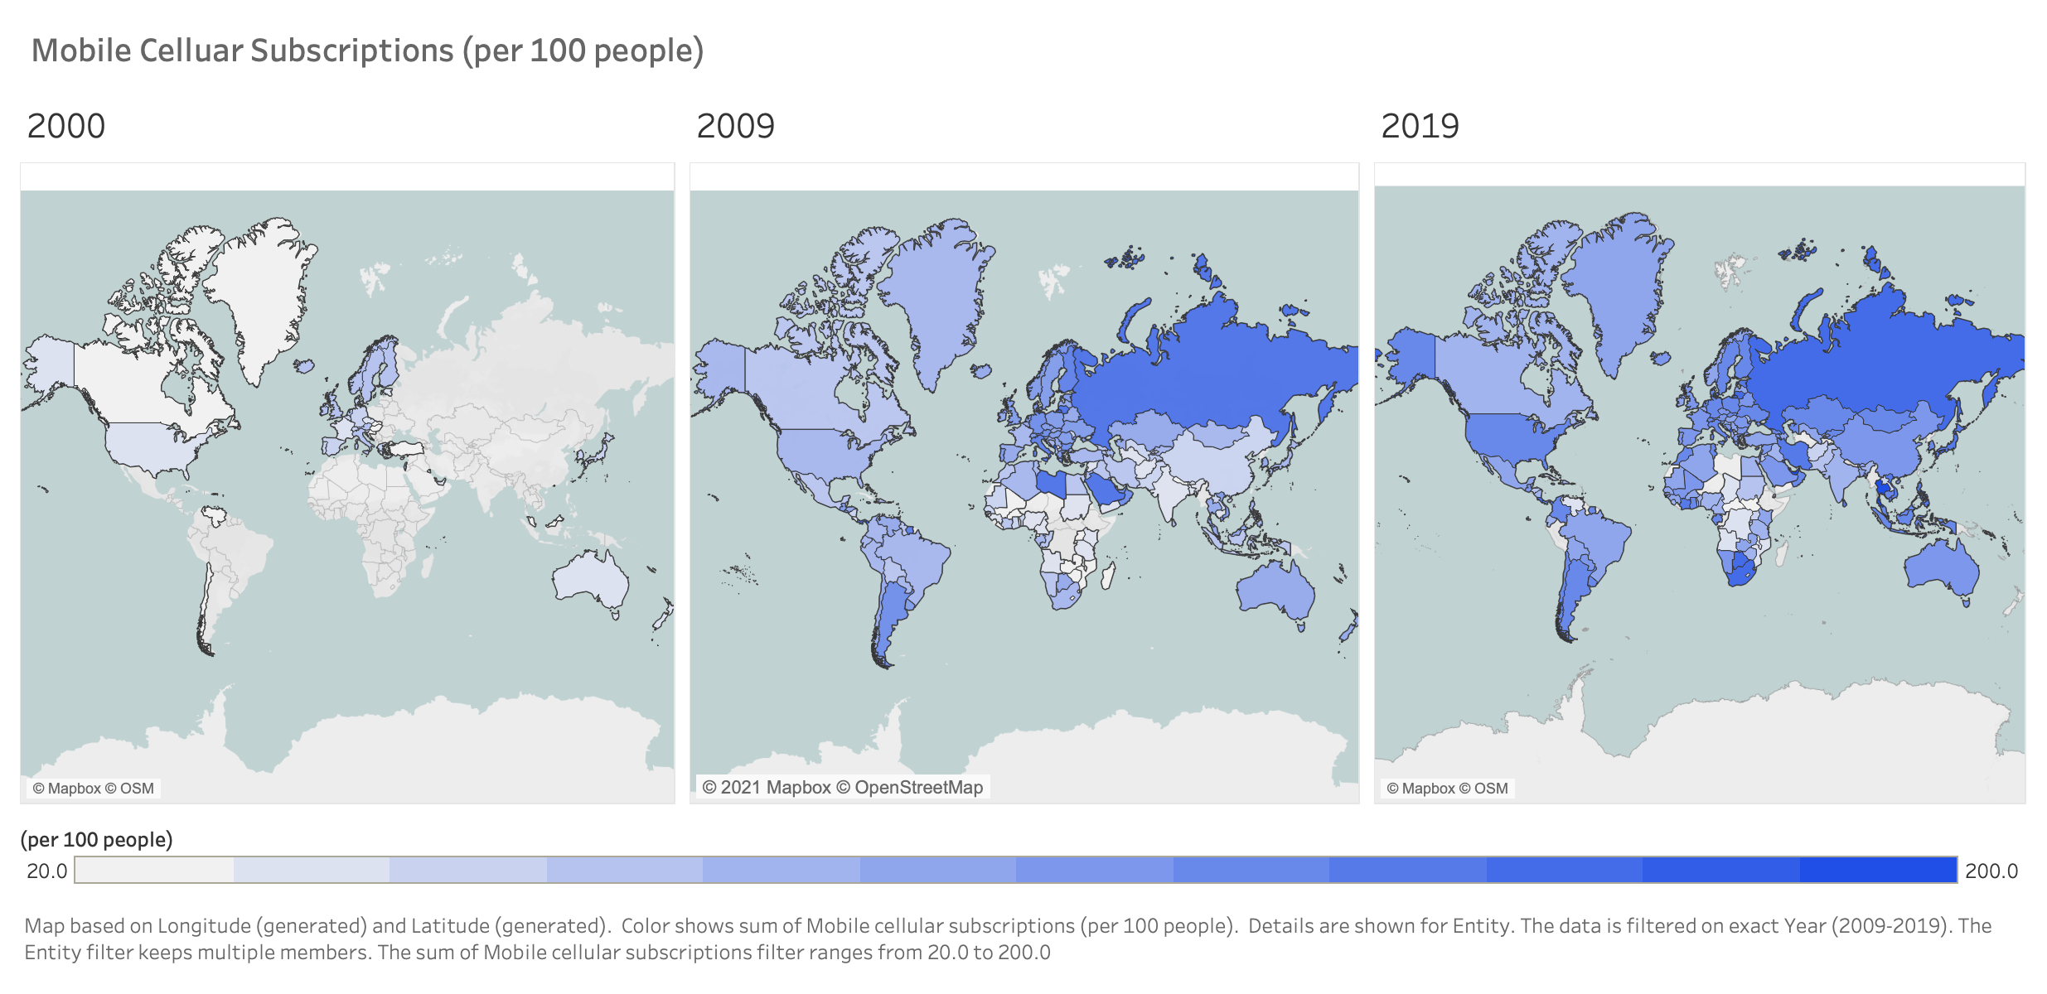
Map based on Longitude and Latitude. Color shows sum of Mobile cellular subscriptions (per 100 people). Details are shown for Entity. The data is filters on exact Year (2000-2019). The Entity filter keeps multiple members. The sum of Mobile cellular subscriptions filter ranges from 20.0 to 200.0

Slide 5
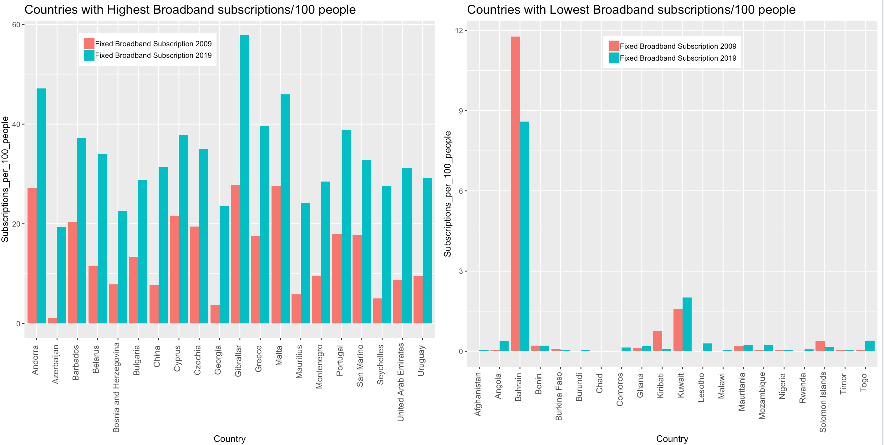

Slide 6
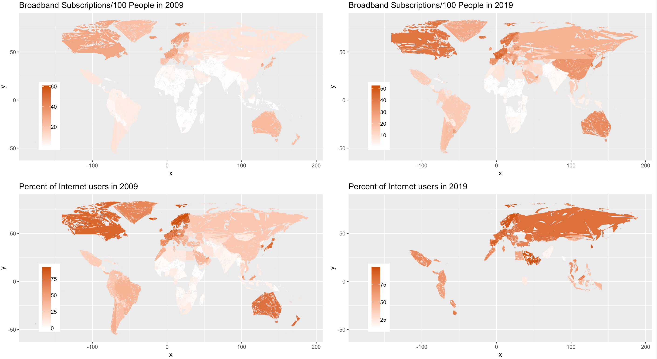

Slide 7
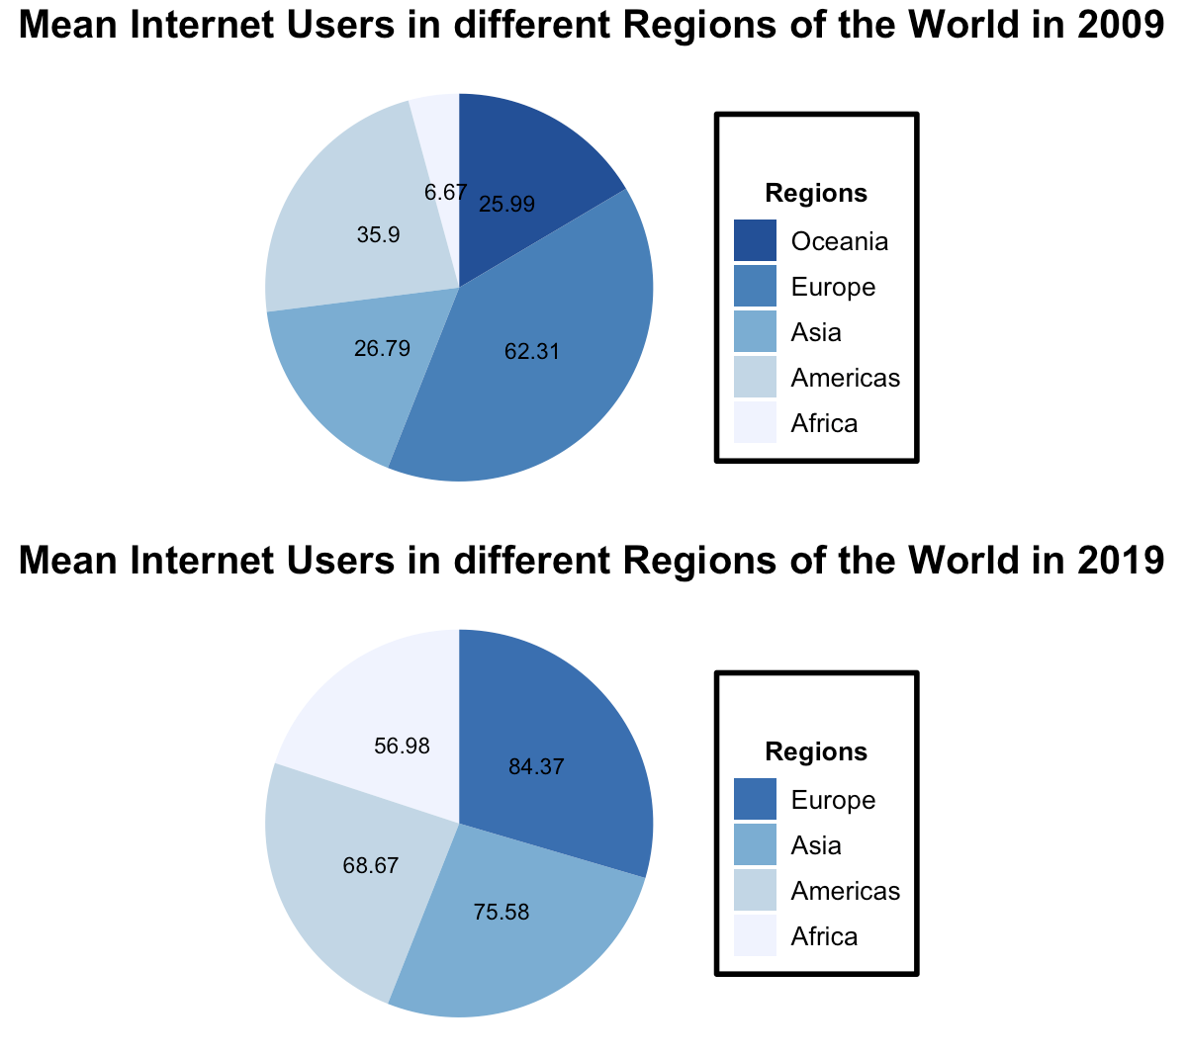

Slide 8
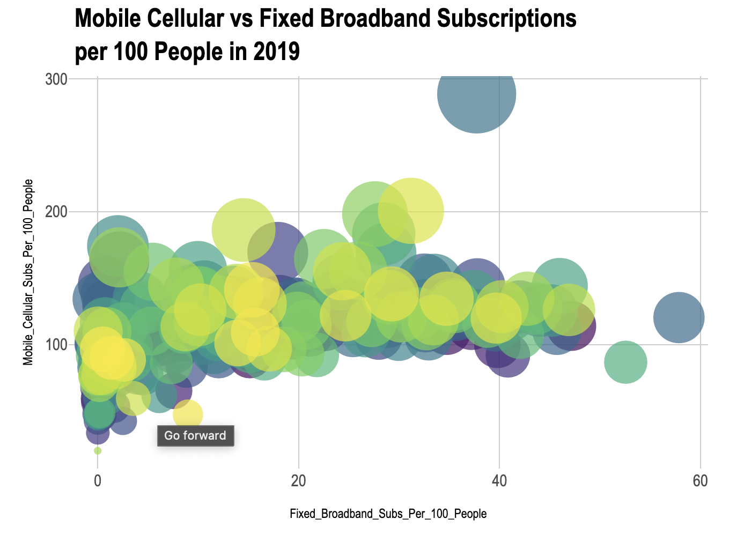
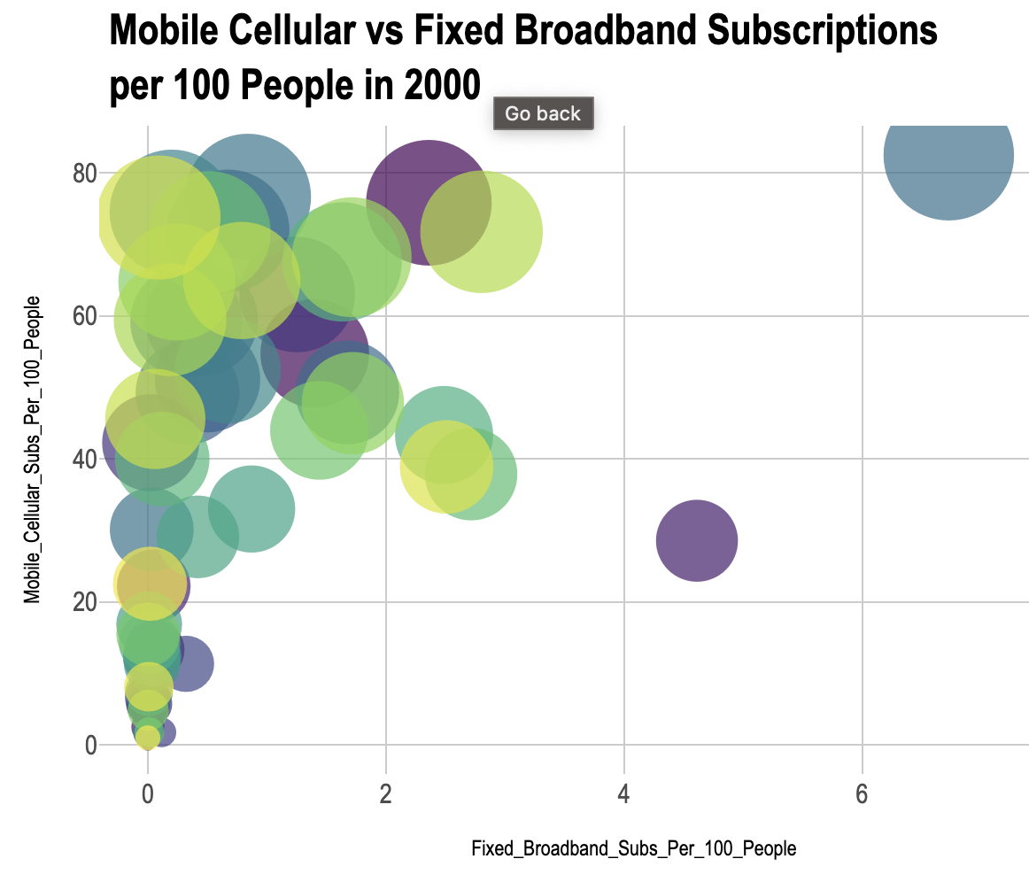
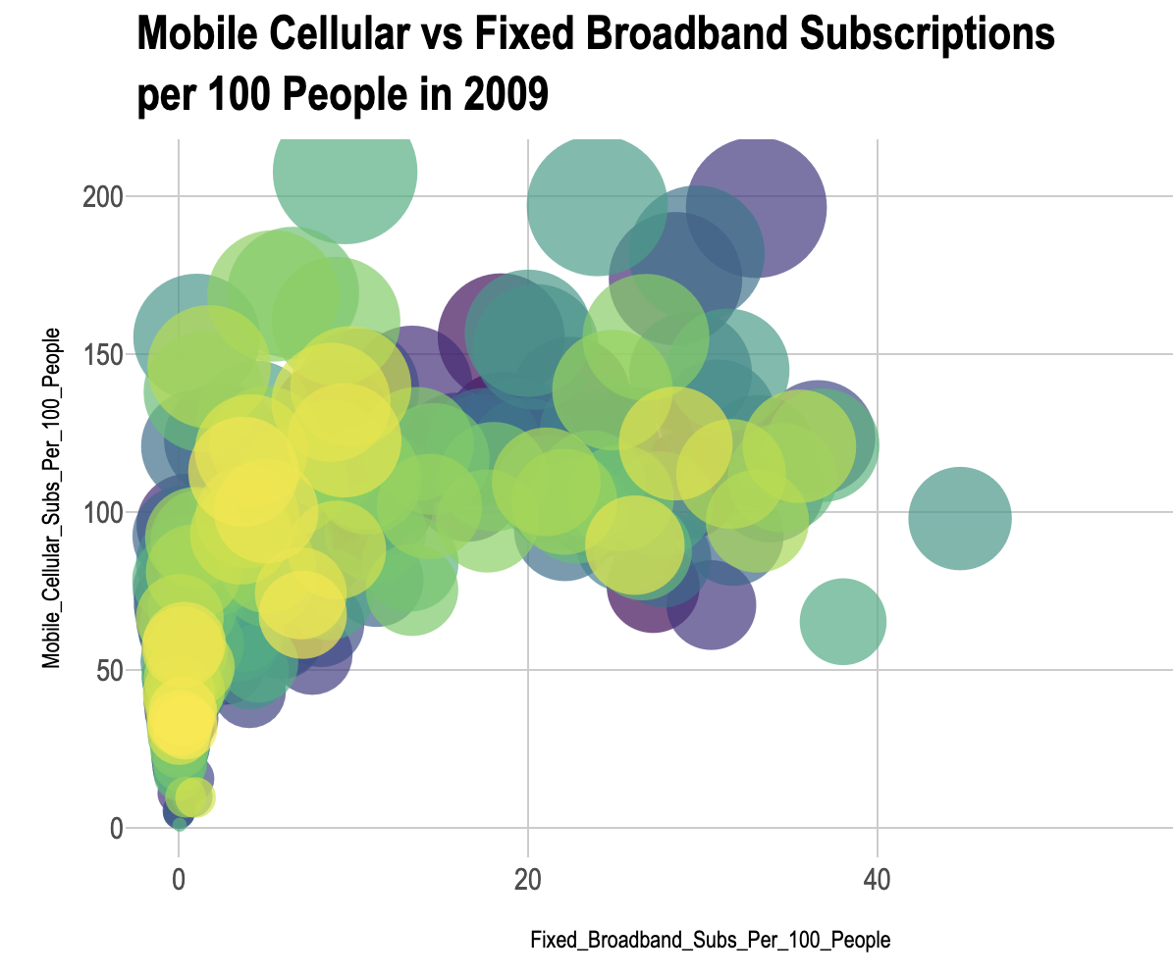
2000.html
2009.html
2019.html

